Slide 1
Azure Purview Glossary

Slide 2
Business Glossary
A glossary provides vocabulary for business users. It consists of business terms that can be related to each other and allows them to be categorized so that they can be understood in different contexts. These terms can be then mapped to assets like a database, tables, columns etc. This helps in abstracting the technical jargon associated with the data repositories and allows the business user to discover and work with data in the vocabulary that is more familiar to them.
A business glossary is a collection of terms. Each term represents an object in an organization and it is highly likely that there are multiple terms representing the same object. A customer could also be referred to as client, purchaser, or buyer. These multiple terms have a relationship with each other. The relationship between these terms could one of the following:
  synonyms - different terms with the same definition
  related - different name with similar definition
The same term can also imply multiple business objects. It is important that each term is well-defined and clearly understood within the organization.

Slide 3
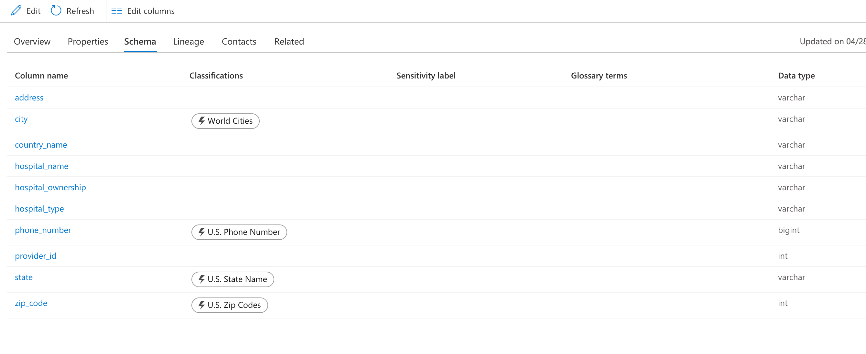
Schema Detection and Business Glossary
Azure Purview identifies the schema during the data scanning/crawling process
Azure Purview supports the creation of business glossary terms that can be used and mapped with the metadata created in the purview metadata catalog

Slide 4
Creating/Importing Glossary in Purview
Navigate to azure portal
Search for the azure purview accounts which we created.
Open Azure purview studio , from the home page click on manage glossary
From the place you can import terms or create a new term.
A specific way needs to be followed if you are importing as a terms.

